Slide 1
Angular framework – Step 9

Slide 2
Angular framework
Angular is open source web framework which help to develop the SPA application.
Angular is a part of google company.
Angular use html, css and typescript.
Angular is component base architecture framework.
To create the angular project we need to use google provide angular cli.

Slide 3
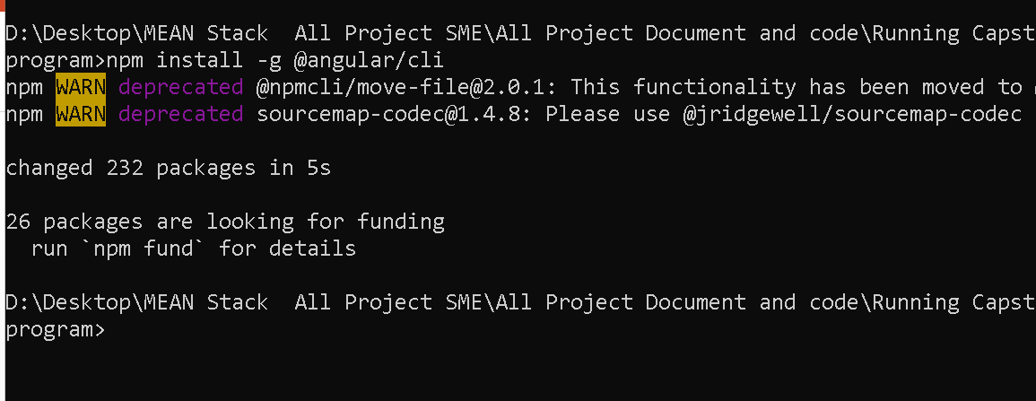
To enable angular-cli using the command as

Slide 4
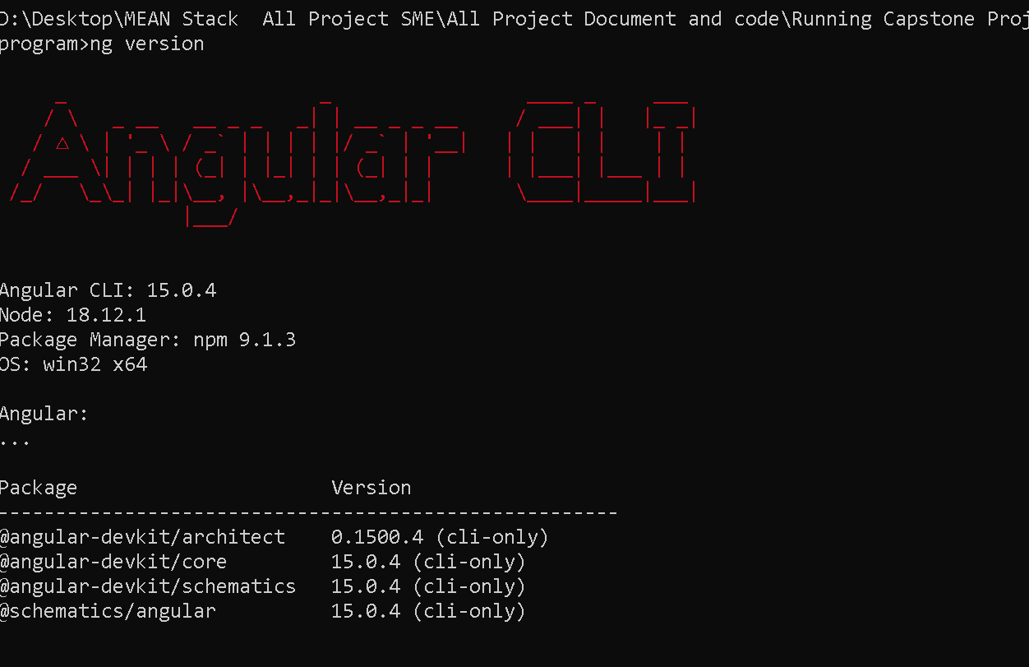
Verify angular cli

Slide 5
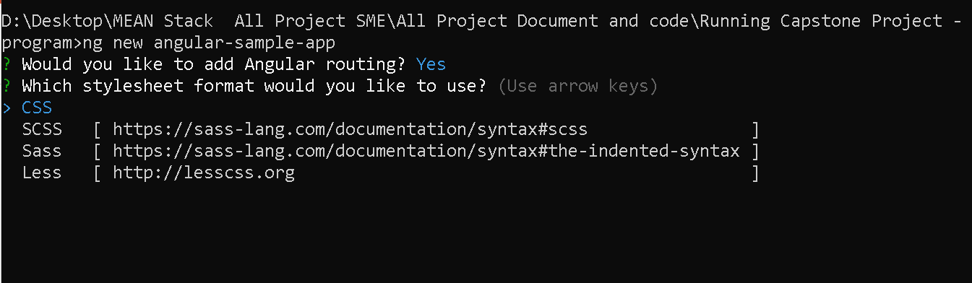
To create the angular project using command

Slide 6
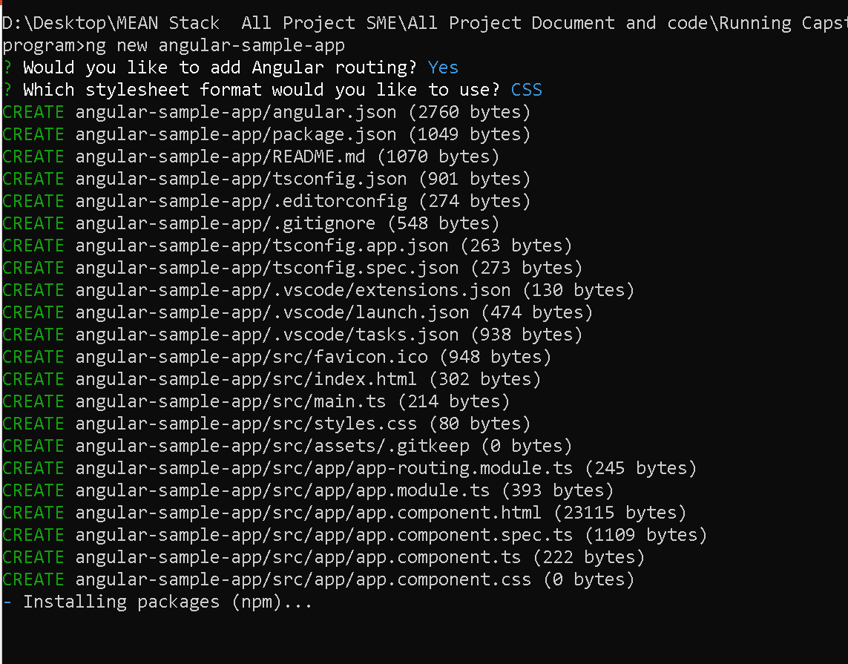
Sample project

Slide 7
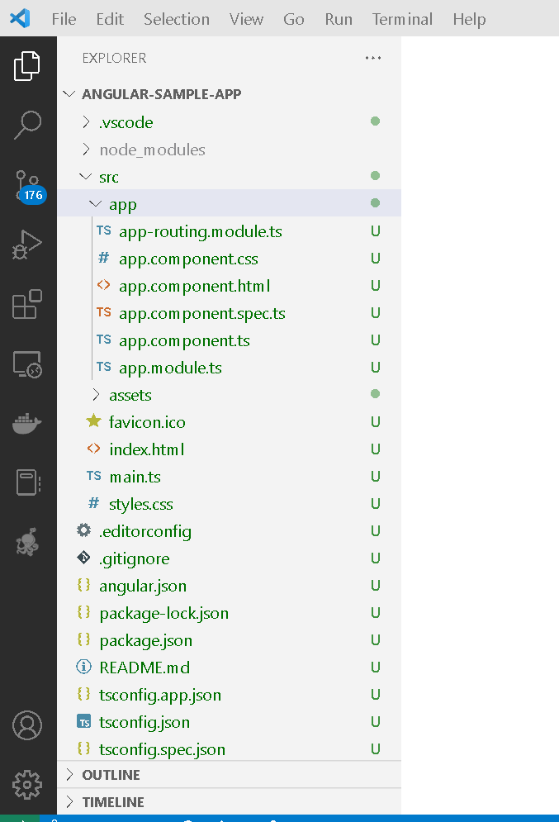
Angular project structure

Slide 8
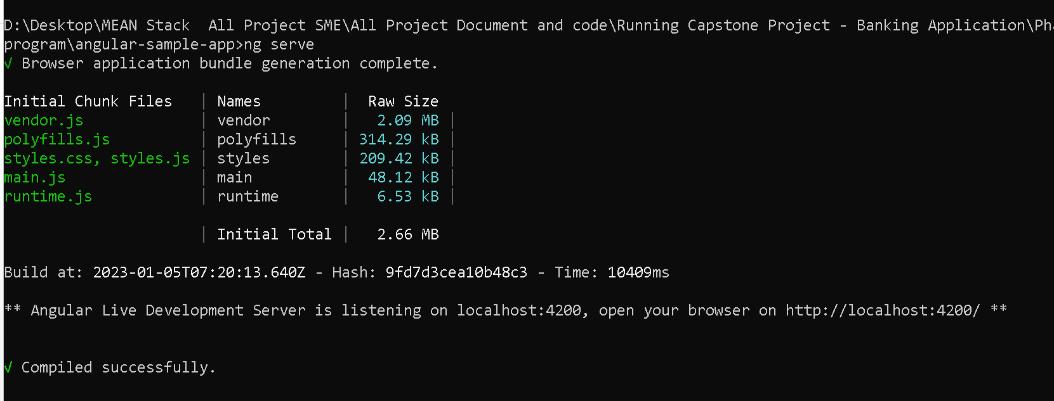
To run the angular sample project
We need to run the commands as
ng serve
It will run on default port number 4200

Slide 9
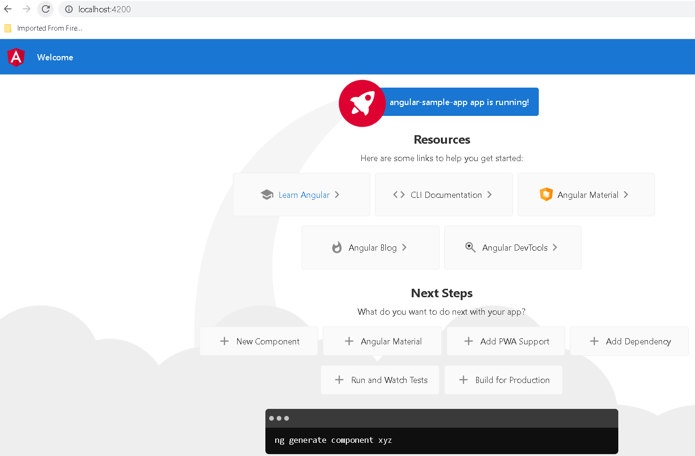
Sample angular project

Slide 10
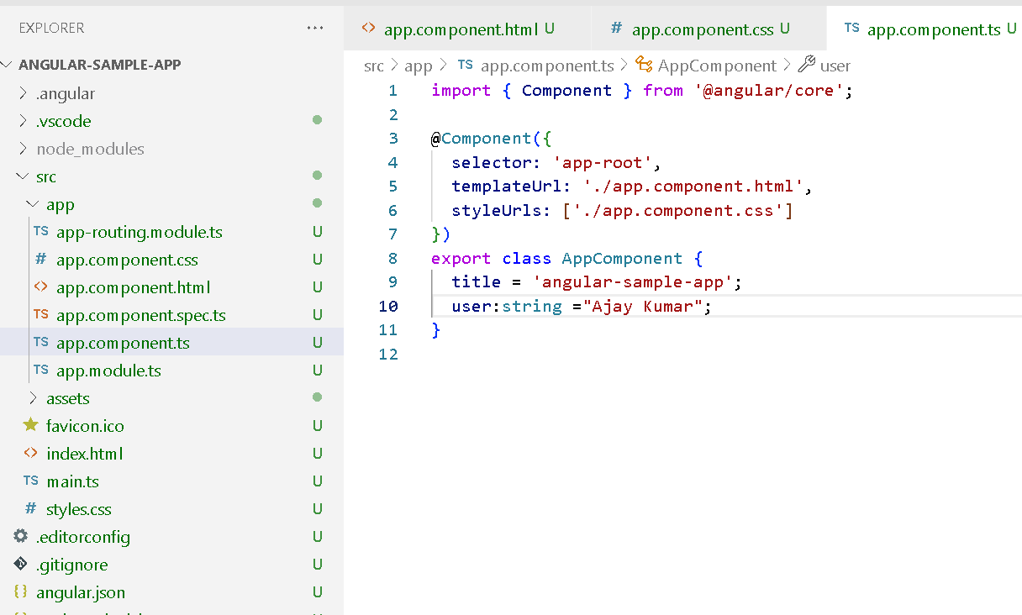
Edit in ts page
Src→app→app.component.ts

Slide 11
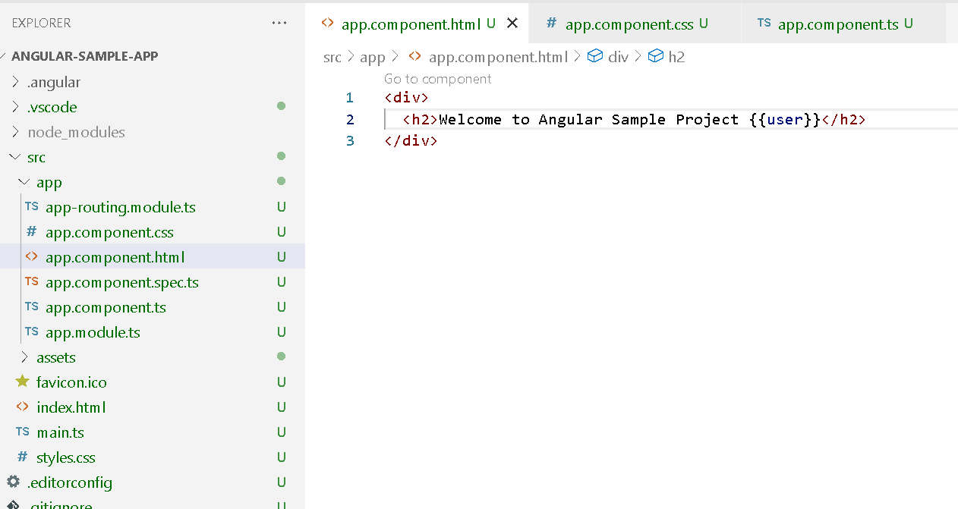
Edit in html page
src→ app→app.component.html page

Slide 12
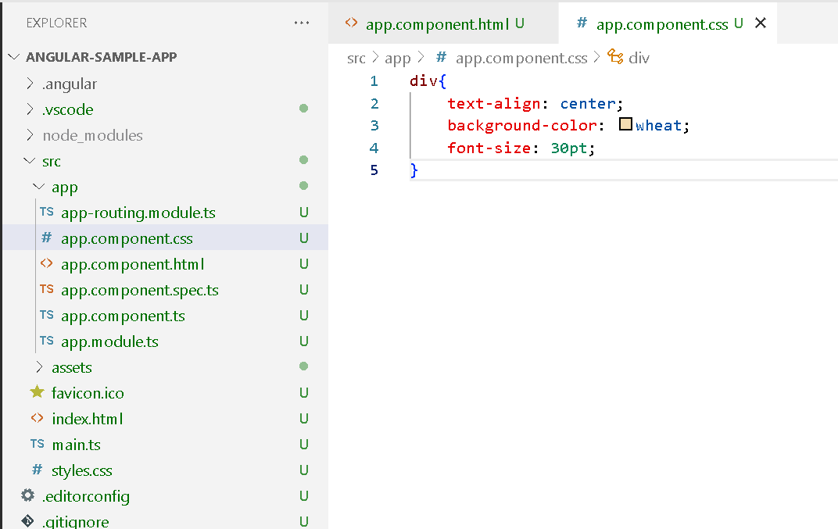
Edit in css page
Src→app→app.component.css

Slide 13
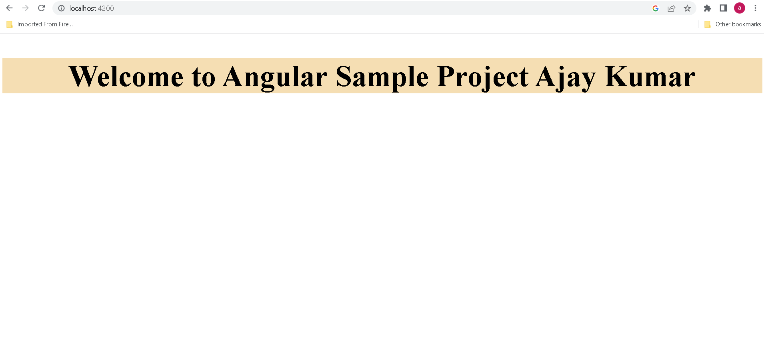

Slide 14
Convert all html pages like index.html, home.html, customerHome.html and adminHome.html page to angular component using command as
Ng g c index
Ng g c home
Ng g c adminHome
Ng g c customerHome

Slide 15
We need lot of model classes and service classes.
Model classes
Ng g class transaction
Ng g class logic
Ng g class customer
We need to create service class
Ng g s customer
Ng g s login
Ng g s transaction

Slide 16
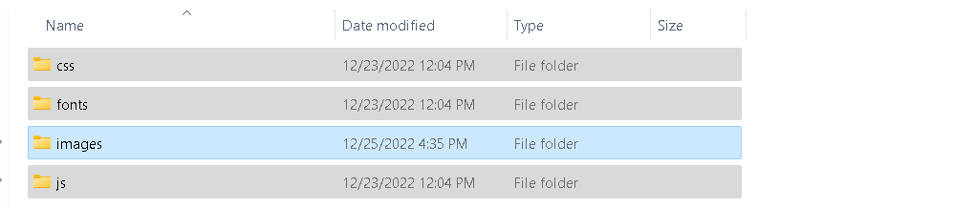
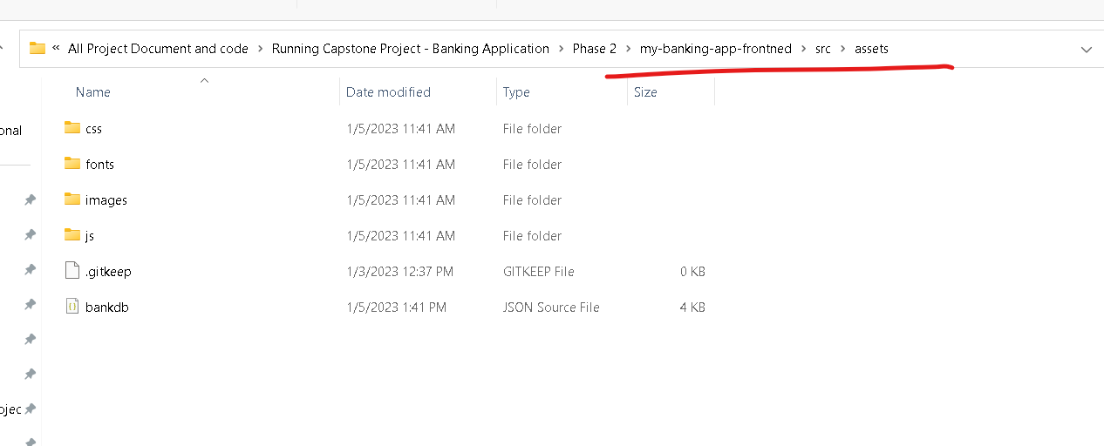
All third party plugin and resources copy and paste in assets folder.

Slide 17
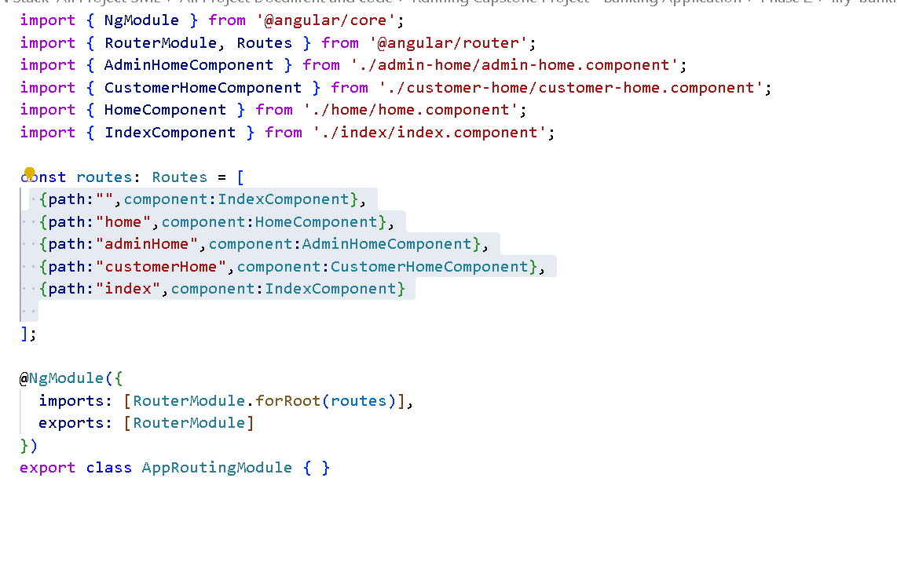
Routing file

Slide 18
Angular
Component
Model
Service
Template driven form and model drivern
Validation don
HttpClient module to call rest api running to json-server

